Slide 1
Edge Computing in 5G: A Review
NAJMUL HASSAN , KOK-LIM ALVIN YAU ,
AND CELIMUGE WU
Department of Computing and Information Systems, Sunway University, Bandar Sunway 47500, Malaysia
Graduate School of Informatics and Engineering, The University of Electro-Communications, Tokyo, Japan
IEEE Access , Page(s): 127276 – 127289 ,
Date of Publication: 30 August 2019

Slide 2
Outline
Abstract
Section 1: Introduction
Section 2: Overviewof 5G and edge computing
Section 3: Taxonomy of edge computing in 5G
Section 4: The state-of-the-art schemes for edge computing in 5G
Section 5: Open research issues
Ssction 6: Concludes

Slide 3
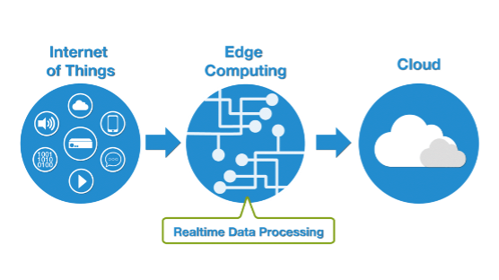
Abstract
Edge computing is a technogy that enables the evolution to 5G by bringing cloud capabilities near to the end users.
Overcome the intrinsic problems of the traditional cloud.
Establish a taxonomy of edge computing in 5G
Notes:
改善QoS(服務品質) 高吞吐量、低延遲
邊緣運算能夠支持5G擁有雲端計算的能力，且比cloud更接近使用者設備
本篇論文將克服固有的雲端計算問題、將雲端運算運用於5G的各項需求,平台,效能,目標等做分類、近年的邊緣運算方法及應用

Slide 4
Introducion
Edge computing : 1. extend cloud capabilities 2. perform computationally-intensive tasks 3. store a massive amount of data at close proximity to user equipment (UEs)
Traditional cloud computing : 1. centralized computing paradigm 2. access to highly capable data centers 3. storage to the data centers
Edge computing is preferred to use wireless communication.
High interactive application , High QoS requirements ,
Notes:
擴增實境、虛擬實境，互相作用
高計算輛

Slide 5
Introducion
Capabilities of UEs warrants the need for edge computing : 1. receive and store a massive amount of real-time data 2. process, compute, and analyze the data 3. make and distribute decisions on mini clouds locally
Edge servers in the mini clouds are located locally instead of remote data centers.
This paper highlights recent advances of edge computing in 5G , applications , key challenges , issues in 5G environment , and MEC architecture.
Notes:
距離使用者設備很遠的cloud

Slide 6
Background -Requirements of 5G systems
5G possesses 3 main characteristaics : 1. A massive amount of data is generated. 2. Stringent QoS requirements are imposed 3. Heterogeneous environment must be supported.
5G is comprised of 3 main new technologies : 1. mmWave communication 2. small cells deployment 3. massive MIMO (multiple-input multipleoutput)
Notes:
資訊爆炸的時代，7.5億行動裝置在2017世界
QoS(服務品質) 低延遲、高吞吐量(視訊、媒體流量)
多元 可操作的使用者裝置(智慧型手機、筆電、平板)可能裝設在異質環境中，異質介面
高頻帶、高頻寬
減少傳送範圍及干擾
允許基礎單位使用大量區段做有方向性的傳送，允許鄰近節點做同時溝通

Slide 7
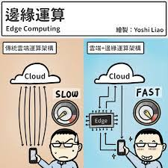
Background –Main characteristics of 5G data
Data can be categorized into 3 main categories according to its time : 1. Hard real-time data 2. Soft real-time data 3. Non-real-time data
Edge computing is envisioned to handle applications and services with hard real-time requirement.
For applications and services with non-real-time requirement, tasks can be offloaded to the cloud for load balancing.
Notes:
嚴格的時間限制，需要低延遲(視訊串流、健康照顧服務設備)
較不嚴格的時間限制，可以容忍一訂限度內的延遲(智慧型交通訊號控制系統)
可容忍延遲的資料
可使用邊緣server因為較接近使用者設備 可以有效降低延遲(到cloud需要較久的時間)

Slide 8
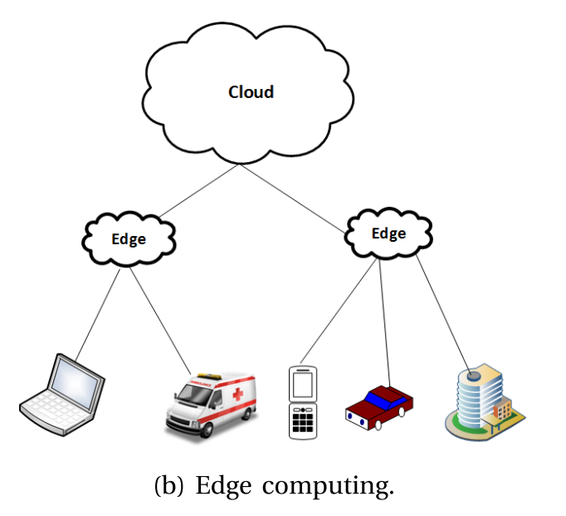
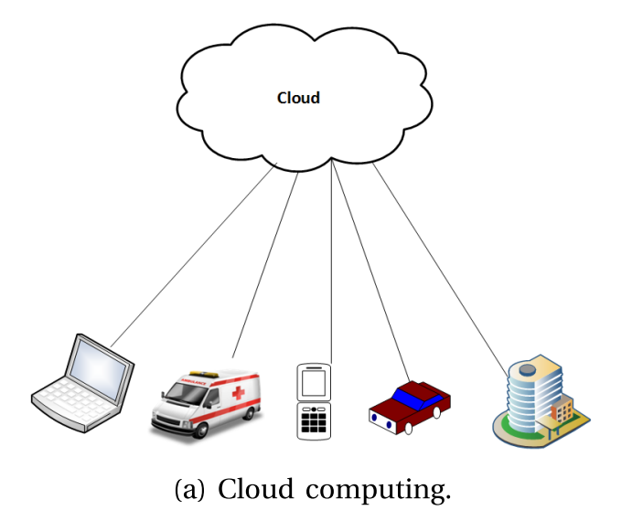
Background –Significance of edge computing
5G is foreseen to support highly interactive applications with low latency and high throughput requirements.
Edge computing adopts a decentralized model that brings cloud computing capabilities closer to UEs in order to reduce latency.
Notes:
不是和互相相關的應用(因為計算需要互相影響、服務品質、低延遲、高吞吐量的追求)
集中式運算、分布式運算(邊緣節點)
邊緣運算 可運作在單一平台或合作平台

Slide 9
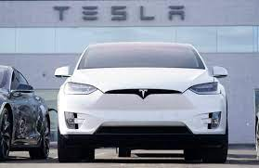
Background –Significance of edge computing
Cloud may be far away from UEs, which also increases energy consumption.
Cloud servers : located at the core network Edge servers of the mini clouds : located at the edge of the network.
The need of edge computing : 1. real-time pachet delivery (self-driving cars) 2. energy consumption
Notes:
不是和互相相關的應用(因為計算需要互相影響、服務品質、低延遲、高吞吐量的追求)
集中式運算、分布式運算(邊緣節點)
邊緣運算 可運作在單一平台或合作平台，更多效能強大的智慧型裝置也成為邊緣運算的平台，使用者只要稍不留意，就有可能淪為駭客的攻擊目標。早在2015年，就有駭客成功駭進特斯拉系統，讓自駕車引擎失效並減速，2019年也有駭客向富比世宣稱，自己已找到漏洞，能夠關閉25000台汽車的引擎。可見在個人裝置中，邊緣運算的安全性仍具有疑慮。

Slide 10
Background –Key requirements of edge computing in 5G
4 key requirements of edge computing in 5G : 1. Real-time interaction : low latency to support delay-sensitive service 2. Local processing : feasible , requests can be processed by edge servers(Bandwidth , Traffic) 3. High data rate transmit the massive amount of diverse range of applications data to edge clouds 4. High availability ensures the availability of the cloud services
Notes:
改善QoS 多元的服務範圍，包誇決策判斷與資料分析
資料與使用者的需求處理可經由邊緣server，而非cloud 頻寬瓶頸、交通大幅減少中心網路的負擔

Slide 11

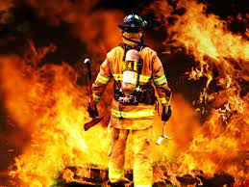
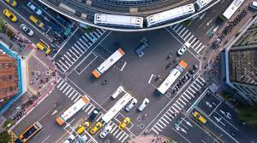
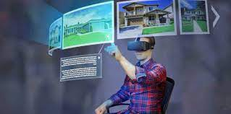
Background –Applications of edge computing in 5G
Applications of 5G : 1. Healthcare 2. Entertainment and multimedia applications 3. Virtual reality, augmented reality, and mixed reality 4. Tactile internet 5. Ultra-Reliable and Low Latency Communication 6. Internet of things 7. Factories of the future 8. Emergency response
Notes:
遠端診斷、手術指導，醫生使用遠端系統讓患者使用到醫療服務
串流HDTV或3D TV
串流收音機內容
提供極端的反應即可靠網路確保正確傳送即時控制訊息
URLLC 在M2M溝通中低延遲傳輸及高可靠性(火警)
智慧型應用(智慧型家電)
智慧型機器可以改善安全及生產率
決策的執行可及時被分享至緊急的反應單位(消防員) 最先到達發生緊急事件的地點
交換即時交通資訊，讓車避免掉交通意外的發生

Slide 12
Taxonomy –Objectives
5 main objectives of edge computing in 5G : 1. Improving data management : Handle a large amount of delay-sensitive data 2. Improving QoS : To support highly interactive applications and service 3. Predicting network demand : Estimate the required network resources 4. Managing location awareness : Infer their own locations and track the location of UEs to support location-based services 5. Improving resource management : Optimize network resource utilization for network performance enhancement
Notes:
D2D溝通 、及時應用(遠端手術)
多元的服務品質需求
有效率的多種資源的分配(頻寬)
外包服務及資料到邊緣cloud 行動使用者裝置可以查詢資訊在較鄰近的地點，而這些查詢可能相關於醫療的緊急用途
多目標的功能、多種範圍的應用、使用者的需求及命令

Slide 13
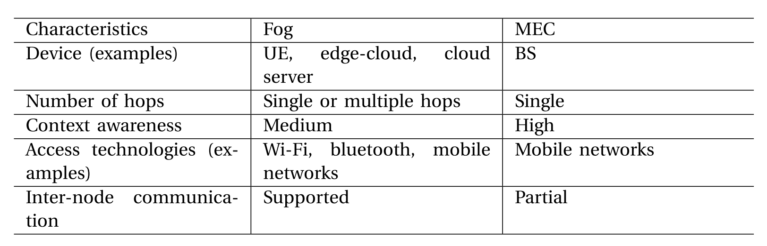
Taxonomy –Computational platforms
Computational platform can be used individually or in combination based on the network scenarios and application/service requirements.
3 main platforms in 5G : 1. Cloud computing 2. Edge computing :Fog computing , MEC 3. Hybrid : Cloud computing + Edge computing
Notes:
提供多樣計算功能，在不同地點處理資料
獨自的:邊緣server擁有即時資訊
合作運用運算平台: 邊緣server處理即時及輕量級資料 Cloud:處理重量級資料
多接取邊緣運算著重於特定功能，Fog計算著重大局，與物聯網做結合

Slide 14
Taxonomy –Attributes
3 main attributes of edge computing in 5G : 1. Low latency and close proximity: 3 main components in a response delay : 1) communication delay depends on data rate 2) computational delay depends on computational time 3) propagation delay depends on propagation distance 2. Location awareness : Edge servers to collect and process data allows location-based and personalized service provisioning 3. Network context awareness : Edge servers to acquire network context information.

Slide 15
Taxonomy –Use of 5G functions
5 major enablers of edge computing in 5G: 1. Software-defined network (SDN) : Separates a network into control and data planes to provide flexible and agile networks. 2. Network function virtualization (NFV) : Virtual functions in virtual machines on servers 3. Massive MIMO : Multiple antenna elements to increase an antenna array at transmitter and receiver 4. Dynamic access to radio access technologies : Access to conventional access technologies 5. D2D communication : Direct communication between neighboring UEs using ad-hoc links
Notes:
Server端的虛擬機可以擁有cloud和edge 防止所有資訊被傳 送到cloud
Wi-fi
Massive意指基地台天線陣列中的大量天線；MIMO意指天線陣列使用同一時間和頻率資源滿足空間上分離的多位用戶的需求。Massive MIMO也認為在實際系統中，天線與使用者終端(以及相反過程)之間傳輸的資料經過了周圍環境的濾波。
鄰近使用者設備使用隨意網路連結進行直接的溝通

Slide 16
Taxonomy –Roles of Edge Computing in 5G
6 main roles of edge computing to support real-time and interactive application and service: 1. Local storage: distributed local storage 2. Local computation : edge computing offloads computation and process 3. Local data analysis : critical and real-time data analysis 4. Local decision making: make real-time decisions and corresponding actions 5. Local operation: remote control and monitoring 6. Local security enhancement malicious entities can be quickly detected and isolated

Slide 17
Taxonomy –Attributes
3 main attributes of edge computing in 5G : 1. Low latency and close proximity: 3 main components in a response delay : 1) communication delay depends on data rate 2) computational delay depends on computational time 3) propagation delay depends on propagation distance 2. Location awareness : Edge servers to collect and process data allows location-based and personalized service provisioning 3. Network context awareness : Edge servers to acquire network context information.

Slide 18
Taxonomy –Performance measures
3 main performance measures: 1. Lower operational cost : Edge computing reduces the operational cost by providing local functions 2. Higher QoS : improves QoS by providing local functions.Edge servers to collect and process data allows location-based and personalized service provisioning 3. Energy efficiency: reduces energy consumption by providing local functions
Notes:
非卸載或傳送任務及資料到cloud，可減少資源的浪費(例如頻寬)、能源的浪費、增加網路的使用時限

Slide 19
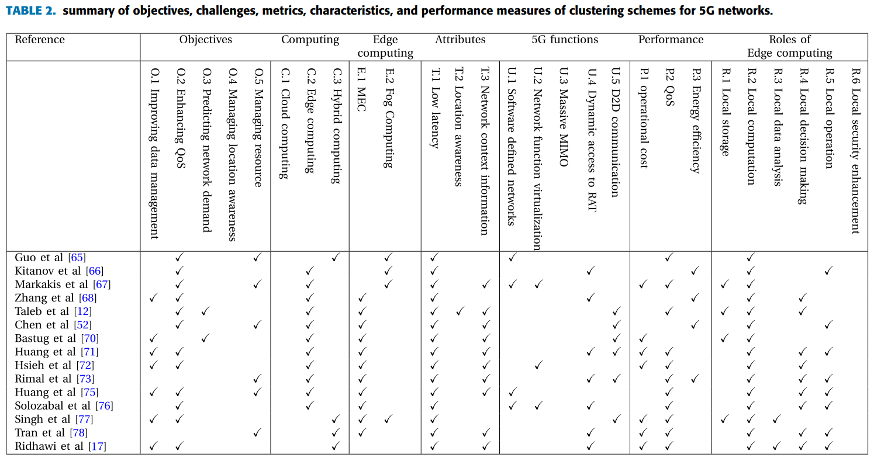
State of the art

Slide 20
State of the art –Fog based solutions
[65]A cross-layer resource management scheme is presented between optical network and fog computing over fiber networks in order to incorporate delay requirements to edge servers.
[66]A comparison of energy efficiency between cloud computing and fog computing is made under different modulation schemes.
[67]An architecture that enables edge servers to provide caching, computing, and communications functions is proposed so that content and service providers can deploy their functions, services, and contents closed to UEs.

Slide 21
State of the art –MEC based solutions
[68]An architecture is presented to perform energy-aware offloading, whereby each mobile UE decides whether to perform or offload computational tasks to MEC server, in order to reduce energy consumption of MEC.
[69] The UEs are heterogeneous in nature as they have different communicationand computing capabilities. The energy consumption of the computational tasks at the mobile UEs is higher than that in the MEC server.
3 steps : 1) mobile UEs are classified 2) priorities are given to the different UEs 3) channels are allocated for UEs
Notes:
多接取邊緣運算
分類根據UE的能源消耗計算與傳送檔案到MEC的延遲時間
根據可用的頻道和頻道品質
根據優先順序

Slide 22
State of the art –MEC based solutions
[12]MEC services are autonomously created by the nearest edge server in order to provide mobile UEs with seamless QoE in video streaming.
[52]A D2D architecture is proposed for a massive number of UEs to execute collaborative tasks in an energy-efficient manner.
[70]A predictive and proactive caching approach is introduced in order to reduce peak traffic demands.
[71] An application-aware traffic redirection mechanism is proposed for MEC in order to reduce response time and bandwidth consumption.
Notes:
12當Ues收到來自Edge server的內容可以減少延遲的時間，也就是高品質的串流
當edge server無法使用時，再到cloud去存取資料，也會增加延遲

Slide 23
State of the art –MEC based solutions
[72]A virtualized multi-access edge computing framework is proposed to increase available bandwidth and reduce end-to-end delay in an intelligent manner in Internet of things.
[73]A fiber wireless (FiWi) access architecture is introduced to improve MEC services.
[75]A group of vehicular neighboring nodes (or VNG) is dynamically managed using SDN to improve control over network and its resources in vehicular networks.
[76]A non-standalone MEC-based architecture is presented for mission-critical public safety services in order to achieve the delay requirement of 5G.
Notes:
73交通及網路效能控制

Slide 24
State of the art –Hybrid solutions
[77]A D2D-based mobile edge and fog computing architecture is introduced to enable collaborative computing in order to enhance MEC.
[78]A context-aware, real-time collaborative architecture is proposed to manage heterogeneous resources at the edge of the network.
[17]A real-time, context-aware, service-composition, and collaborative architecture is proposed to deliver fast composite service.
Notes:
78異質資源(儲存、計算能力在不同計算平台或階層)
17加強多重服務 以支持合作的不同硬體或軟體能力

Slide 25
OPEN RESEARCH ISSUES
5 issues for edge cloud in the 5G : 1. Service enhancement : QOE The challenge is to achieve a balanced trade-off between : higher availability or seamless connectivity of an application and higher QoE of the application. 2. Standardization of protocals 2 main challenges : agree upon a standard and a large number of heterogeneous UEs use different interfaces to communicate with the edge cloud. 3. Addressing heterogeneity Heterogeneity in communication and computing has resulted in difficulties in developing a solution across different environment. 4. Security and privacy
Notes:
4.動態環境導致資料和網路需求變換快速、增加的裝置互相溝通需要解決方法，信任與資安管理就很重要(健康資訊)

Slide 26
Conclusion
We present a review of the state-of-the art development in edge computing, including fog-based , MEC-based , and hybrid solutions, in 5G networks.
The key requirements of edge computing are to provide real-time interaction, local processing, high data rate, and high availability.
Edge computing in 5G provides numerous benefits, the convergence of both edge computing and 5G brings about new issues that should be resolved in future.

Slide 29
SlidesCarnival icons are editable shapes.
This means that you can:
Resize them without losing quality.
Change line color, width and style.
Isn’t that nice? :)
Examples:

Slide 30
Diagrams and infographics

Slide 31
You can also use any emoji as an icon!
And of course it resizes without losing quality.
How? Follow Google instructions https://twitter.com/googledocs/status/730087240156643328
✋👆👉👍👤👦👧👨👩👪💃🏃💑❤😂😉😋😒😭👶😸🐟🍒🍔💣📌📖🔨🎃🎈🎨🏈🏰🌏🔌🔑 and many more...

Slide 32

Free templates for all your presentation needs
For PowerPoint and Google Slides
100% free for personal or commercial use
Ready to use, professional and customizable
Blow your audience away with attractive visuals

